Slide 1
Test Plan Presentation
Group 9: Metro Database
Kylie Callison, Kendall Gesek, Pamela Shahu, & Erika Valle-Baird

Slide 2
Introduction: Goals & Objectives
MoonEyes: a case management system for a private detective agency. The main purpose of this project is to create a process that allows agents from Metro Detective Agency to submit and track case information (including client, subject and agent details)
The testing process for MoonEyes will ensure that the system is performing as intended, no major errors or lags in the system, and the system has met all standards and requirements stated in the Product Backlog.
The system must also have an aesthetically pleasing interface, be able to be high performing, and be easy for an agent to navigate and use.

Slide 3
Introduction: Statement of Scope
Black-Box testing to ensure software is working from a user’s perspective using test cases.
Unit testing will verify each component of the system is working properly and testing boundaries such as valid information being entered in to the database, automatic sign out, and search parameters are displaying correct information.
Integration testing to test interaction between database, web application, and user interface.

Slide 4
Introduction: Statement of Scope
Performance testing to verify multiple agents can use the system at the same time.
Smoke testing will be used after the system is deployed to verify application is running correctly in environment and if more testing is necessary.
Validation testing to ensure all requirements of MoonEyes have been met and properly implemented in the system, and the application is functioning as intended.

Slide 5
Introduction: Major Constraints
Funding
Funding to afford more database and cloud security functions through Amazon.
Time
Though the testing will be thorough, there will be a time limitation on more extensive testing or further testing on issues that may arise after our completion of the project.
Experience
Lack of an experience as developers, also the ability to access an experienced hacker to ensure our program is functioning properly and securely.

Slide 6
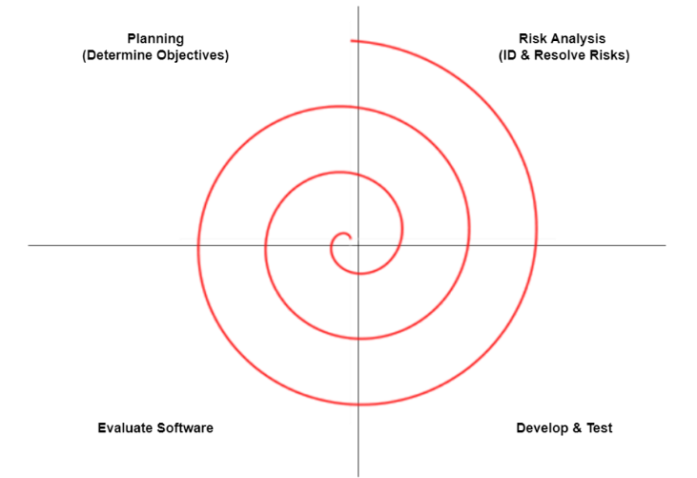
Test Plan
Due to our client’s evolving and changing needs, we have adopted the spiral approach for both our software development and testing. This approach is depicted below. Such an approach allows us to identify requirements not satisfied for our clients, along with allowing us to both change and implement any future developing customer needs. The advantage of this approach is that by getting a model out sooner, testing can be done much more rapidly and efficiently, with each new iteration of the spiral.

Slide 7
Software (SCIís) to be tested
Individual engine components will be tested separately. Interface components to be unit tested include:
Wireframing
New Project Wizard
Database Construction
Database Communication with Interface
Exporting PDF File Ability
Components to enable our clients informational help when needed that will be tested involve:
Interface Help
Engine Help
Database Help
Tutorials
Engine components to be tested are:
Object Handler
Text Handler
Logic Handler
Attribute Handler
Unit Pathing
File I/O Parser

Slide 8
Testing strategy
Black-Box Testing
Performance and Smoke Testing
Flexibility for New Functionality
Auditing
Reviewing
Code Inspection
Design Inspection
Simulation
Functional Testing
Standardization (IEEE)
Walkthroughs
Unit testing
Stress testing
Process Approach
Evidence-Based Decision Making
Relationship Management

Slide 9
Unit testing
Unit testing is a crucial step in the development of MoonEyes. This type of testing will be used in the development of the system to ensure that each component is working properly before moving on to integration testing, as well as testing boundaries. Some of these boundaries include validating the information being entered by an agent; security measures such as an automatic sign out after 60 minutes of inactivity; and ensuring that the search parameters are displaying the correct information. Black box testing will be conducted to test each function and component of the software. Entry and exit conditions will be identified to safeguard the software components from compatibility issues.

Slide 10
Integration testing
After the successful development of unit testing, the focus will shift to integration testing between multiple units. The integration testing will be used to test the interaction between the database, cloud-based web application, and the user interface. The main focal point of the integration testing is to validate the information the agent is entering or changing is updating correctly in the database and the information can be successfully and efficiently queried.
As our software is implemented on a cloud-based web application, we do not have to test at any physical client location as a cloud-based system can be testing from any physical location with the same results. We will however, ensure that there are no software, cloud, or network components that could possibly conflict and cause issues.
Integration testing will include protecting the database from any loss should any deviation from the norm occur. This will be conducted by beginning with our login window, then moving through each part of the software application.

Slide 11
Validation testing
The use of validation testing will validate that all of the requirements of the MoonEyes have been met and implemented in the system. As well as the system is functioning as intended.
Mock data files have been created for testing purposes. This was done to establish the validity of software for our clients. With this mock data, we can obtain results for testing data. These results will be inspected for congruence with System Requirements Specifications. Validation testing will be rendered on all components and subcomponents of the software.

Slide 12
High-order testing
High-Order testing will be conducted on the completed system. Such testing includes beta testing of our product. Best testing will be conducted in an attempt to run through a somewhat fully functioning Metro Detective Agency mock session. Coupled with this, we will be blending recovery, security, and stress testing in our high-order testing.
Recovery Testing
As the Metro Detective Agency database must maintain information stored in it, the software’s ability to retrieve any data lost is crucial to our clients. Should the system shut down, we must ensure data was not lost.
Stress Testing
Employing the stress testing method allows us to monitor any stress our system may encounter. Should multiple administrators or users be concurrently logged into the system, we must ensure system abilities.
Security Testing
As our system employs secure client information, security testing must be conducted to ensure data security. This data is crucial to our client’s business, and therefore of the utmost importance in security testing concerns.

Slide 13
Testing resources and staffing
Due to our small team size, we will all take part in managing, designing, preparing, executing, and resolving relevant issues and test activities. To ensure issues are resolved, frequent meetings are set up to review and discuss outstanding and resolved bugs, decisions, goals, as well as any changes the client would like to have. Therefore, our testing employs an egoless and democratic structure as is illustrated below. The smaller group size allows for open communication among the team regarding the project decisions, products, and goals.

Slide 14
Constraints
Constraints our team will encounter include both time and limited knowledge, as all members are currently students at the University of Michigan, Dearborn. Other constraints are described in detail below-
Funding
As mentioned, we will need to deploy MoonEyes on a cloud-based hosting service. This means it will cost anywhere from $10-50/month for our client.
Time
Because this project is for our senior design project we have a strict eight-month development timeline. It is possible that we might want to make improvements or add additional features down the road that are incompatible with the amount of time left. Additionally, all members of the team will also be balancing class and work responsibilities along with our project.
Experience
Because our group consists of students with limited professional development experience, we may have to do more independent and team research than a typical development team.

Slide 15
Test work products
Test procedures and sequencing of those test procedures are incorporated in test implementation work products. Our team has integrated Requirements-based testing due to our clients evolving needs and specifications.

Slide 16
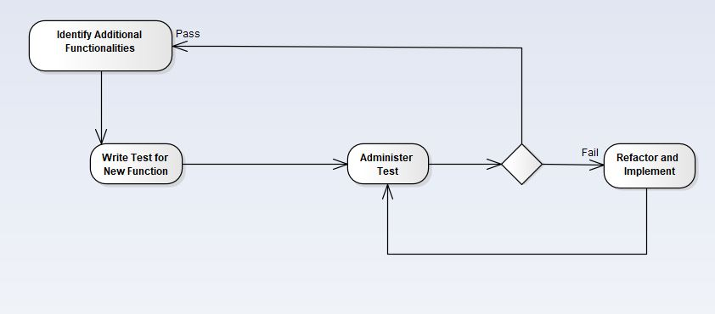
Requirements-based testing

Slide 17
Requirements-based testing
Test procedures and sequencing of those test procedures are incorporated in test implementation work products. Our team has integrated Requirements-based testing due to our clients evolving needs and specifications.
Steps for development are comprised of-
Identifying additional functionalities.
Writing a test for this new functionality.
Administering the test.
As the test has not yet been implemented, it initially fails.
Refactoring, Implementing, and Re-running the Test.
Upon successful test runs, the next functionality determined begins the test development stage.

Slide 18
Test work products
Work products produced
The producer will make an informal change request.
During the review the recorder will take notes and reference the checklist. A review summary report will be made with details on the decisions made and if any changes need to be made before the modification is pushed.
Test monitoring and control work products-
Monitoring of tests and control work products will include test progress reports and test summary reports.
Test Execution of work products
Our team will log the status of individual test cases. These logs will include labels on such cases like “ready to run”, “pass”, “fail”, and “deliberately skipped”. Furthermore, defect reports will be maintained for proper documentation and regulation. Such documentation will include which test items, objects, tools, and ware were involved in any testing performed.
Test Completion work products
Test summary reports will be completed upon completion of tests for future reference. This helps our team track defects and issues, along with how they were resolved, in a manner that helps future testing.

Slide 19
Test record keeping
As aforementioned, our team will log the status of individual test cases. Such logs will be maintained and stored. Here, the log will also allow us to monitor any tests that have been conducted and applied. Furthermore, these reports audit any utilized tests. We will also store and evaluate test records by the following devices.
Audit Logs
Session Management
Data Validation and Error Handling
Access Control List

Slide 20
Test metrics
Schedule Adherence
The purpose of this metric is to determine the difference between scheduled expected and actual execution times. This metric enables our team to estimate the progress, quality, and health of our software. In addition to this, it enables us to adhere to project schedules as this project must adhere to a tight finishing deadline.
Defects finding rate
This metric aids in measuring the quality of our software product and testing capabilities. It also aids in recognizing patterns of flaws our product is facing over a specified time period.
Defect fixing time
In order to ensure timeliness of defect fixes, a defect fixing time metric will be employed. This will measure the amount of time required to correct the issue.
Test coverage
Aiding in verification of coding sequences as well as testing functionality, we will use a test coverage metric. The number of test cases assigned to the program will be indicated. This metric will make certain that testing is completed thoroughly.
Fault Profiles
As our clients have a prioritization of needs, we will employ the fault profile metric to both categorize and prioritize any discovered errors.

Slide 21
Testing tools and environment
Hardware Requirements:
PC or Laptop with
Minimum 8GB RAM
Access to Web Browser
Internet Connection
Software Requirements:
Visual Studio
Or Visual Studio Code
Access to MySQL
The test environment will be provided via the testers.
The tester must have the ability to connect to the database server.
In addition, an outstanding account with Github.com needs to be created before access to the code can occur.
The tester can obtain the most recent build through Github.com
New builds will not be pushed to the page until consistent testing has been conducted.

Slide 22
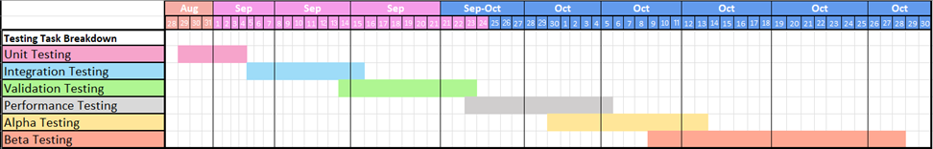
Test schedule
Below, is an outline of the most recent test schedule for project Mooneyes.

Slide 23
Testing Procedures

Slide 24
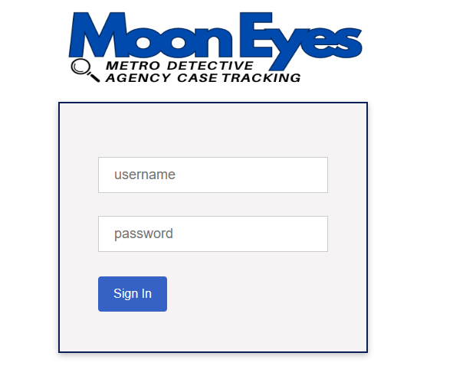
Sign In Component
Test Cases:
Successful Sign In
Incorrect Password
Non-Existent Username
Empty Fields
Purpose:
Validate sign-in functionality under various scenarios.
Expected Outcomes:
Successful authentication, error messages for incorrect credentials, and empty fields.

Slide 25

Home Component
Test Cases
View Open Cases
View New Entries
View Recently Added Clients
View Recently Added Subjects
Purpose:
Ensure accurate and up-to-date data display in the home component.
Expected Outcomes:
Display relevant case, client, and subject information correctly.

Slide 26
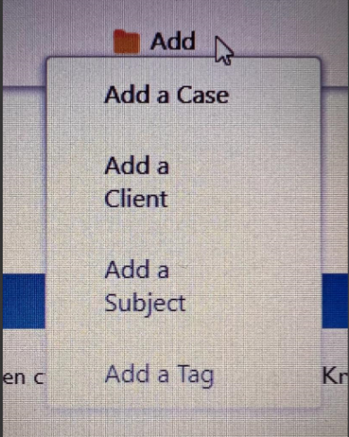
Add Component
Test Cases:
Add a New Case
Add a New Client
Add a New Subject
Add a New Tag
Purpose:
Validate seamless addition of new cases, clients, subjects, and tags.
Expected Outcomes:
Successful addition of cases, clients, subjects, and tags.

Slide 27

Search Component
Test Cases:
Search for New Cases
Search for Old Cases
Purpose:
Ensure effective search functionality for both new and old cases.
Expected Outcomes:
Correct search results based on specified criteria.

Slide 28

Admin Controls Component
Test Cases:
View Recently Added Agents
Add a New Agent
View Metrics - Cases Solved Last Month
Purpose:
Validate administrative tasks and data accuracy in the admin controls.
Expected Outcomes:
Accurate audit logs, agent details, and metrics display.

Slide 29

LogOut Component
Test Case:
User Logout
Purpose:
Ensure secure termination of user sessions.
Expected Outcome:
Successful user logout and session termination.

Slide 30
Integration Testing
Testing individual components together to identify integration issues.
Test Case 1: Add Case and Update Client Information
Test Case 2: Search for Case and Modify Subject Information
Test Case 3: Add Tag to Case and View Audit Logs
Purpose:
Specific cases ensuring components work together seamlessly.

Slide 31
Validation Testing
The validation testing procedure involves systematically testing all components of the MoonEyes project to ensure they are functioning correctly and as intended.
Validation Test Cases and Purpose:
Cases ensuring data integrity, persistence, and accurate search results.

Slide 32
Security Testing
SQL Injection Vulnerability Test (Initial)
We initially failed an SQL injection test, but we resolved the issue by implementing PDO-prepared statements, effectively preventing SQL injection. Consequently, we now successfully pass the test case.
Authentication Testing:
MoonEyes did authentication testing to ensure that only authorized users can access specific resources.
Data Encryption Testing
Data is encrypted and stored securely.

Slide 33
Stress Testing
Test Procedure:
Input a large volume of data into the system, including extensive case details, client information, and subject records.
Test Cases:
Populate the system with a high volume of data, approaching or exceeding the system's documented capacity.
Purpose:
Evaluate system stability and responsiveness under stress conditions with a substantial amount of data.

Slide 34
Performance Testing
Test Case:
Measure the time taken to load and display the main dashboard upon login.
Purpose:
Ensure the system loads and displays the main interface within a reasonable timeframe (ideally within 9 seconds).

Slide 35
Alpha/Beta Testing
Test Procedure:
Release the system to a limited audience of internal users (Alpha) and a broader group of external users (Beta) for real-world usage and feedback.
Test Cases:
Gather user feedback, identify bugs, and assess user satisfaction and system performance.

Slide 36
All team members actively participate in testing MoonEyes. We utilize our personal PCs with Visual Studio Code and GitHub for testing purposes.
Utilization of open-source tools such as Visual Studio Code and GitHub for development and testing.
WhatsApp group chat is used for real-time bug reporting and communication among our team.

Slide 37
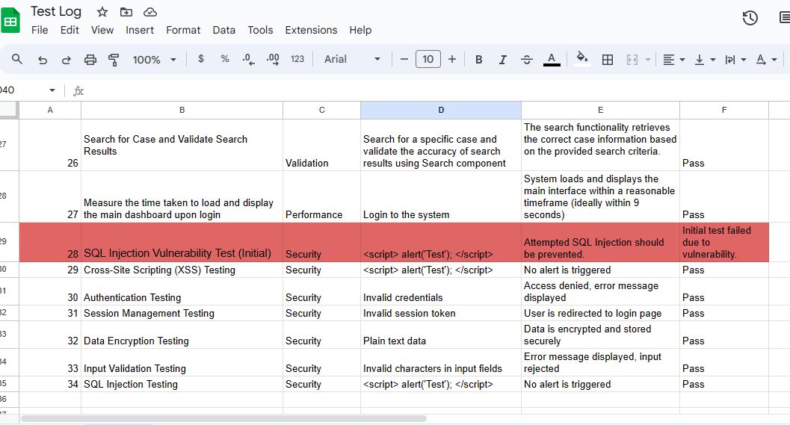
Test Log

Slide 38
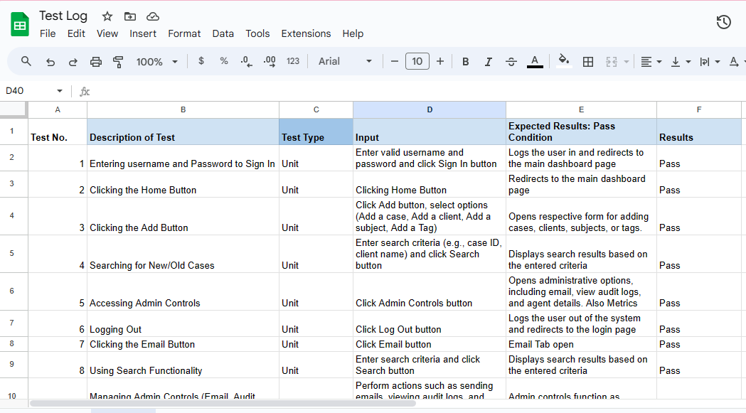

Slide 39
Thank you!

